Slide 1
Control flow
Week 1, Day 4

Slide 2
Announcements
ATTENDANCE has been delayed
If you have any problems, talk to the ICT Office
Culture Class every Wednesday
Friday – QUIZ!
Friday – 4PM Mr. Yim’s Speech
If you want hubo files, please bring a usb

Slide 3
Review - Functions
Functions are a series of steps to accomplish a certain task
A block of organized, reusable code for a single action
Example of a function:

Slide 4
Function Parameters
However, what if we want to make hubo move different number of times?
Parameters are a variable in method definition
Parameters

Slide 5
Simplification of a Task using Parameters

Slide 6
Parameter vs Argument
Parameter
The formal variable as part of the definition
Argument
The actual values you put in the function
Parameters
Arguments

Slide 7
Review- Data Types
Numbers
Strings
Booleans

Slide 8
Review- Variables
We can use variables to store objects.
Assignment
Naming rules
special rules: cannot use def, if, else, while, for, True, False.
Letters, digits, underscores(_).
First character should not be a digit.
Case-sensitive.

Slide 9
Review- Conditionals
Often a program must make a decision depending on the environment.
We used if, else, elif.
if(it rains):
Hubo.study()
elif(it snows):
Hubo.sleep()
elif(it is windy):
Hubo.watch_tv()
else:
Hubo.dance()

Slide 10
Review- Boolean Expressions
Expression that evaluates to True or False.
New operators:
<=, >=, ==, !=, < , >
All these return True or False.
Don’t confuse with =

Slide 11
Review- Hubo Using conditionals
hubo.move()
If hubo.on_beeper():
hubo.pick_beeper()
def move_and_pick():
hubo.move()
if hubo.on_beeper():
hubo.pick_beeper()

Slide 12
Review- Hubo using conditionals
Newer solution:
hubo.move_and_pick()
X 9

Slide 13
Review- Hubo using conditionals

Slide 14
Can we simplify further?
How do we simplify the x9 part?
We need something to repeat some instructions a fixed number of times.

Slide 15
For - loops
A for loop repeats an instruction a fixed number of times.
for i in range(5):
print(“I love this class!”)
I love this class!
I love this class!
I love this class!
I love this class!
I love this class!

Slide 16
Solution-2
hubo.move()
If hubo.on_beeper():
hubo.pick_beeper()
for i in range(1,9):
hubo.move_and_pick()
X 9

Slide 17
While-loops
Repeats an instruction while a condition is true.
while sunny outside:
hubo.dance()
Explanation of code:
Hubo dances while it is sunny outside. If not sunny anymore, hubo stops dancing.

Slide 18
Solution-3
Newest solution:
while hubo.front_is_clear():
hubo.move_and_pick()

Slide 19
Example
We only have a hubo.turn_left()
Can we define hubo.turn_right() using what we learned?
Hint: use for-loops.
def turn_right():

Slide 20
Example
We only have a hubo.turn_left()
Can we define hubo.turn_right() using what we learned?
Hint: use for-loops.
def turn_right():
for i in range(3):
hubo.turn_left()

Slide 21
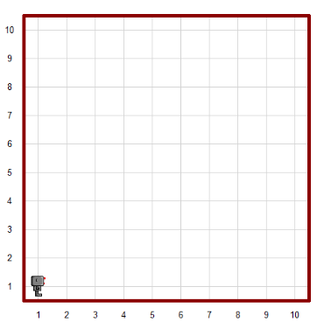
Challenging Example
Write a program that makes hubo walk along the boundary of the map until he comes back to the original position.(hint: Use beepers!)

Slide 22
Challenging Example 2
Steps outline:
Put down a beeper to mark the starting position.
Move forward until reaching a wall.
Turn left.
Repeat steps 2 and 3 until we find a beeper.
Finish when a beeper is found.

Slide 23
Challenging Example 2
How do we change that to code?
Steps outline:
Put down a beeper to mark the starting position.
Move forward until reaching a wall.
Turn left.
Repeat steps 2 and 3 until we find a beeper.
Finish when a beeper is found.
Code:
hubo.drop_beeper()
hubo.move()
while not hubo.on_beeper():
if hubo.front_is_clear():
hubo.move()
else:
hubo.turn_left()

Slide 24
More Boolean Expressions
We learned that Boolean expressions are expressions that evaluate to True or False.
We can use AND, OR to create more complex Boolean expressions.
Let’s see examples!

Slide 25
AND - &
In Python, we use & to represent AND.
AND is used for combining several boolean expressions, to create a bigger boolean expression.
The whole expression is True if all of the Boolean expressions are true.
The whole expression is False if at least one of the Boolean expressions is false.
Let’s look at examples!

Slide 26
AND - &
True & True -> True

Slide 27
AND - &
True & True -> True
True & False -> False

Slide 28
AND - &
True & True -> True
True & False -> False
False & False -> False

Slide 29
AND - &
True & True -> True
True & False -> False
False & False -> False
Hubo.on_beeper() & False -> ???

Slide 30
AND - &
True & True -> True
True & False -> False
False & False -> False
Hubo.on_beeper() & False -> False

Slide 31
AND - &
True & True -> True
True & False -> False
False & False -> False
Hubo.on_beeper() & False -> False
True & True & False -> ???

Slide 32
AND - &
True & True -> True
True & False -> False
False & False -> False
Hubo.on_beeper() & False -> False
True & True & False -> False

Slide 33
OR - |
In Python, we use | to represent OR.
OR is used for combining several boolean expressions, to create a bigger boolean expression.
The whole expression is True if at least one of the Boolean expressions is true.
The whole expression is False if all of the Boolean expressions are false.
Let’s look at examples!

Slide 34
OR - |
True | False -> True

Slide 35
OR - |
True | False -> True
False | False -> False

Slide 36
OR - |
True | False -> True
False | False -> False
True | True -> True

Slide 37
OR - |
True | False -> True
False | False -> False
True | True -> True
Hubo.on_beeper() | False -> ???

Slide 38
OR - |
True | False -> True
False | False -> False
True | True -> True
Hubo.on_beeper() | False -> True

Slide 39
OR - |
True | False -> True
False | False -> False
True | True -> True
Hubo.on_beeper() | False -> True
True | False | False -> ???

Slide 40
OR - |
True | False -> True
False | False -> False
True | True -> True
Hubo.on_beeper() | False -> True
True | False | False -> True

Slide 41
Summary of today’s lesson
Loops
For-loops, while-loops
Hubo instructions using loops and conditionals.
hubo.turn_right()
Making hubo go around map
More Boolean Expressions using & and |

Slide 42
Lab Session
Week 1, Day 4

Slide 43
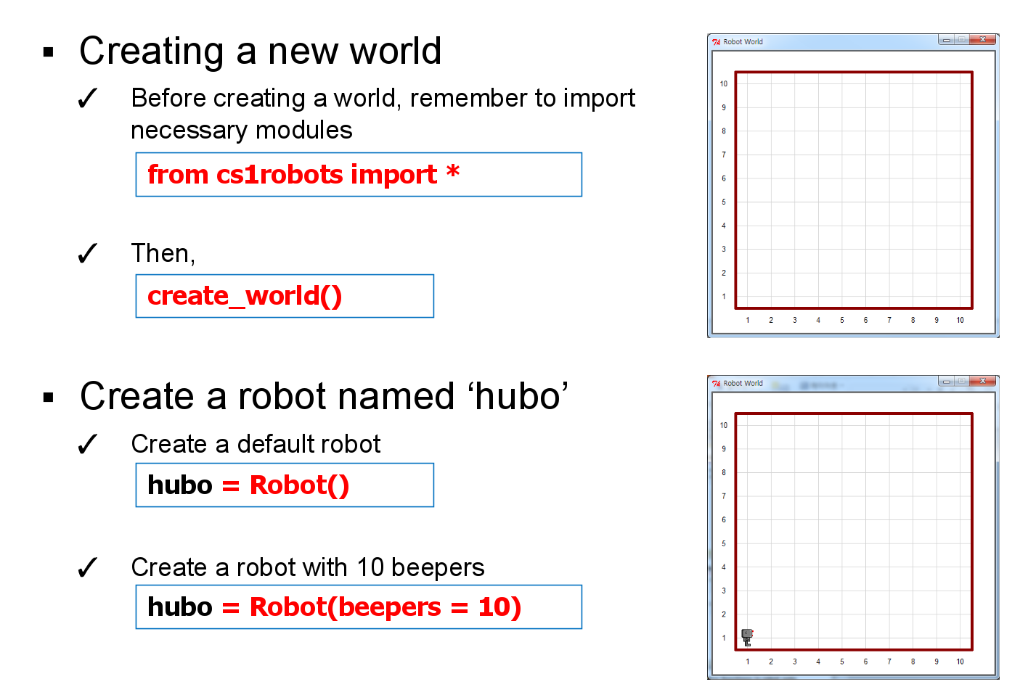
Previously...

Slide 44
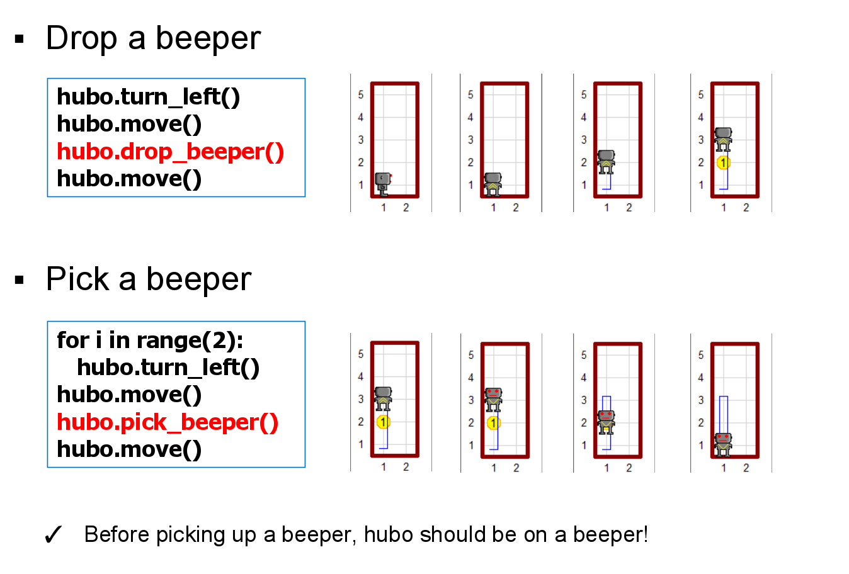
Previously...

Slide 45
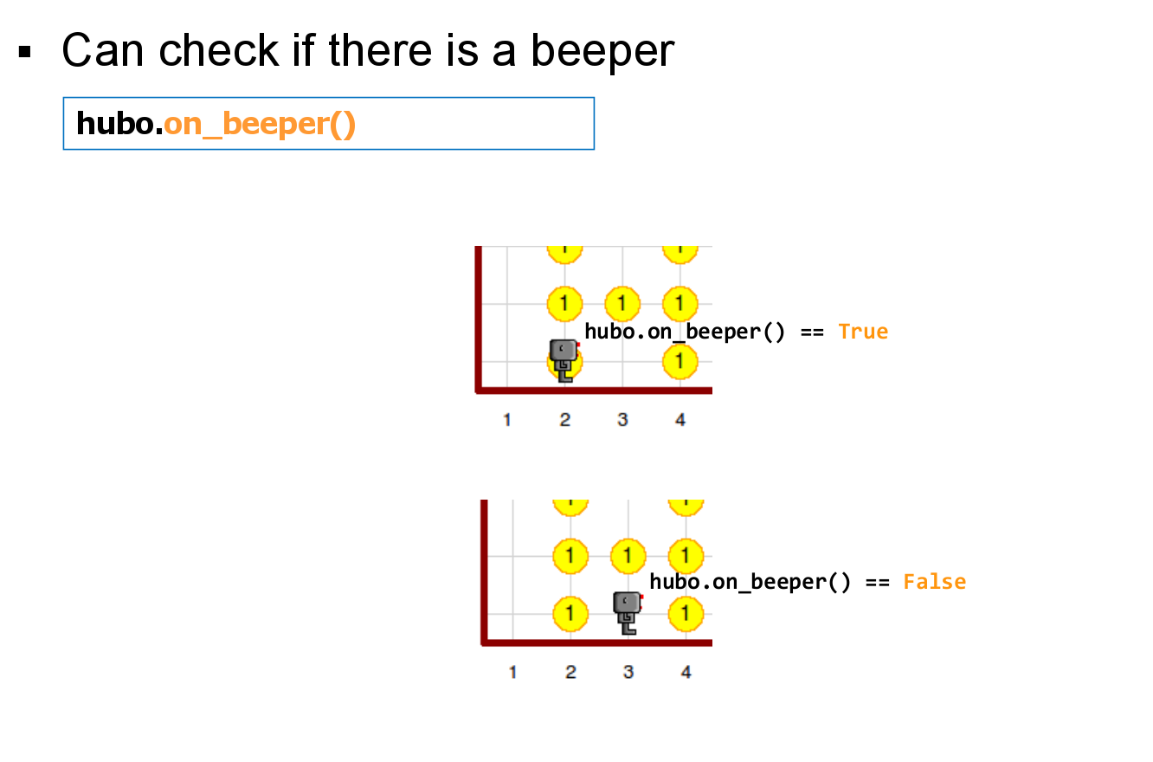
Previously…

Slide 46
New functions!

Slide 47
Advanced Hubo Labs
Remember hubo?
We will tackle harder Hubo labs using the concepts learned.
Use the concepts until now to simplify tasks.
Defining your own functions.
For-loops for repetition
While-loops for repetition.
Conditionals.

Slide 48
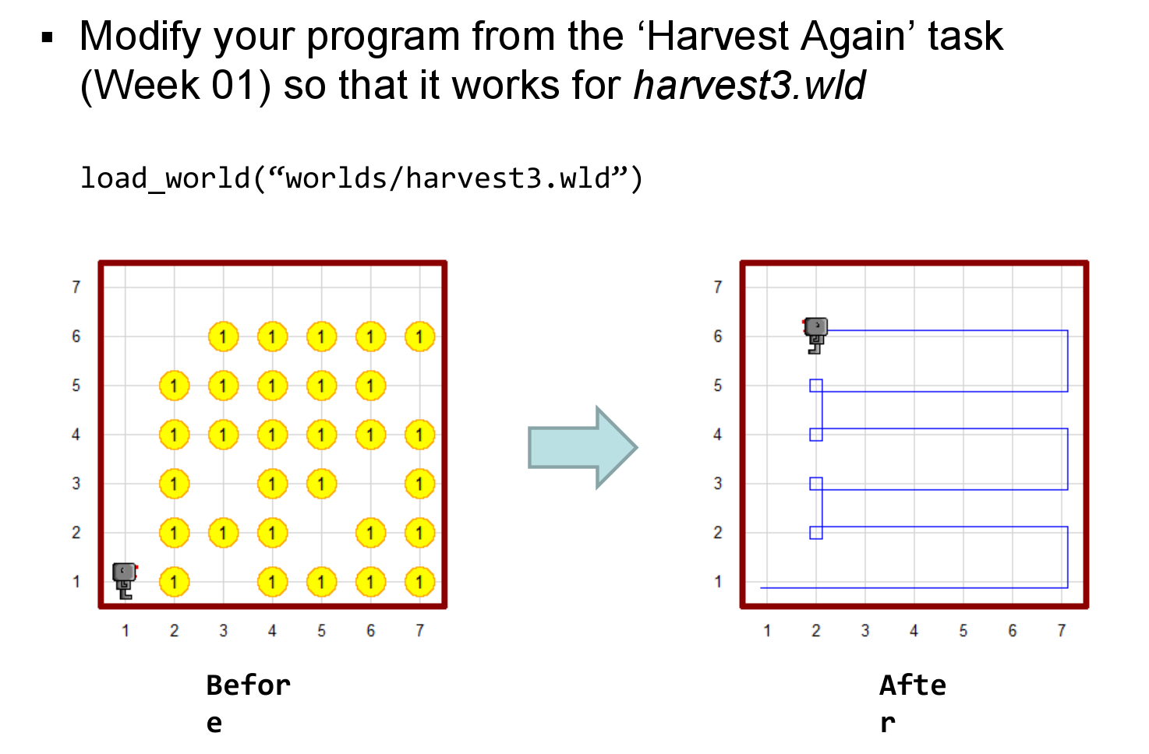
Task 1

Slide 49
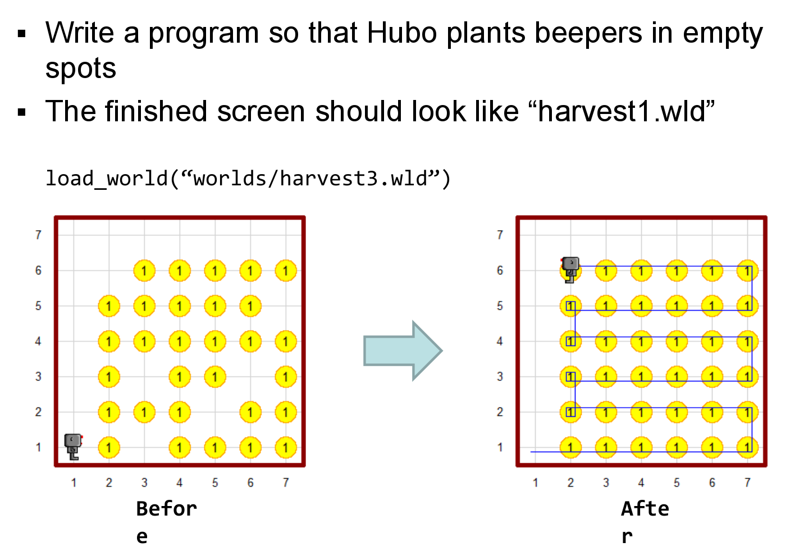
Task 2

Slide 50
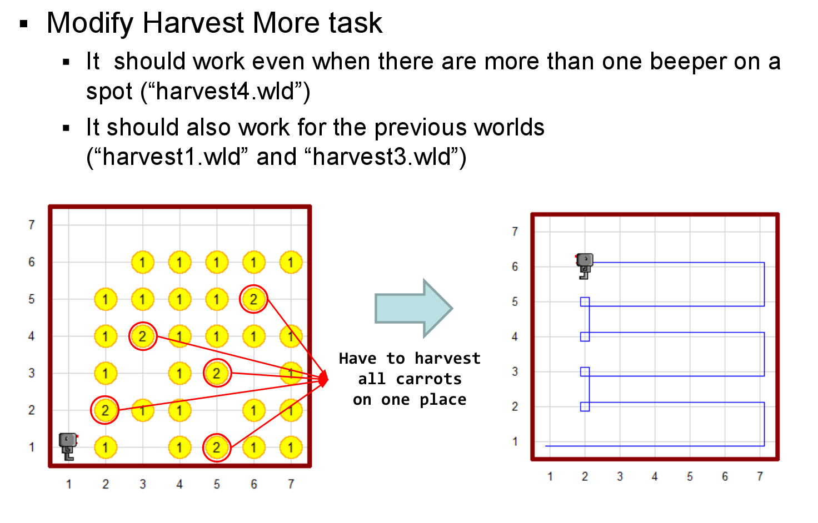
Task 3

Slide 51
Task 4
maze1.wld
Create hubo, make him pick up beeper.
Make him come back to original position.
Drop beeper.

Slide 52
Task 5

Slide 53
Extra
Making hubo navigate any maze.
Ask the TAs if you finish everything!

Slide 54
Good luck!

